Slide 1
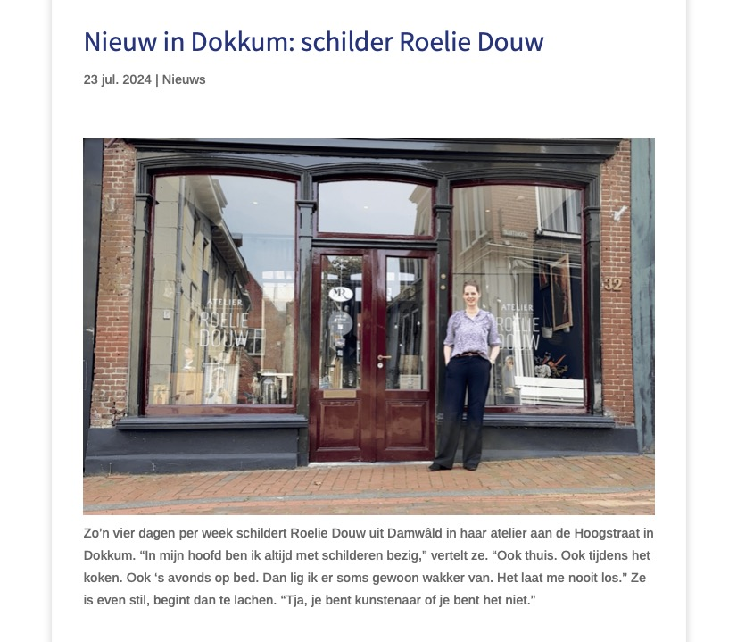
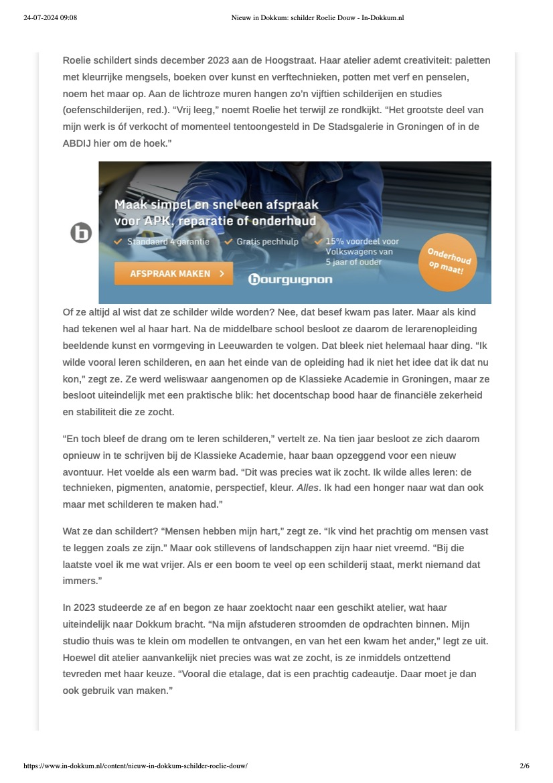

Slide 2
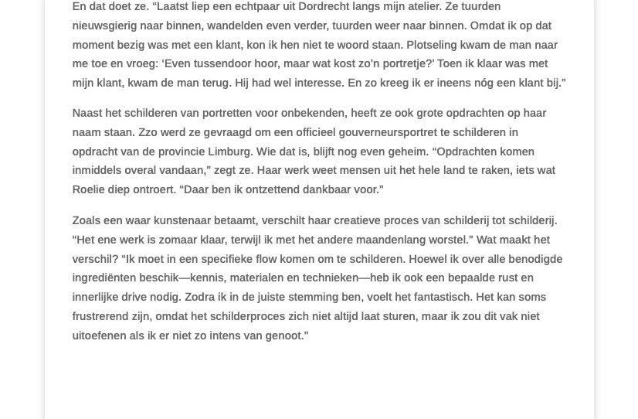
https://www.in-dokkum.nl/content/nieuw-in-dokkum-schilder-roelie-douw/

